Slide 1
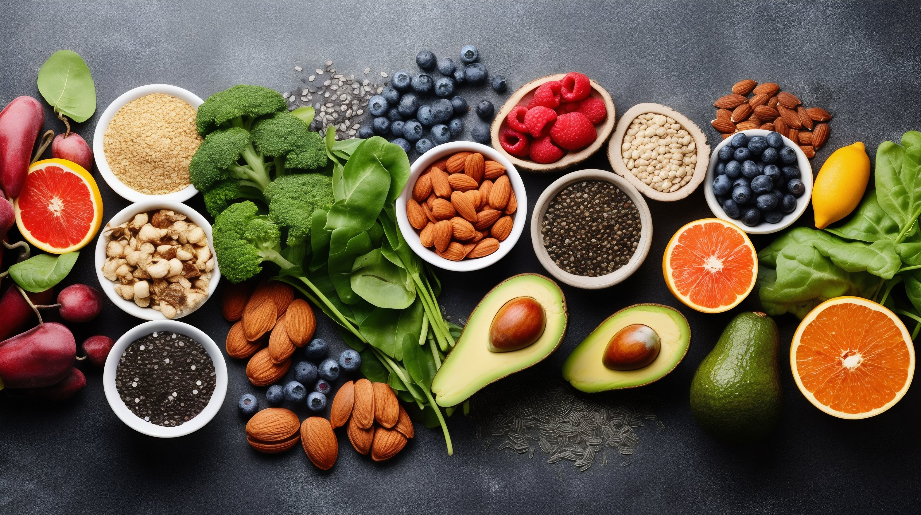
FOOD CALORIE ESTIMATION
GROUP: PG 9
MEMBERS:
ALFIAMOL AJIMSHAN SEMEENA
ALFIYA AZIZ TAMBOLI
RUKHSANA PARILAKATHOOTT SHAJAHAN
TANISHKA BHISE
YASHICA JAIN

Slide 2
PROJECT TIMELINE
R1
R2
R3
R4
R5
PROJECT TOPIC, OBJECTION, DATASET
DATA ANALYSIS AND EXPLORATION
CLUSTERING
BASELINE TRAINING AND EVALUATION EXPERIMENTS
NEURAL NETWORKS

Slide 3
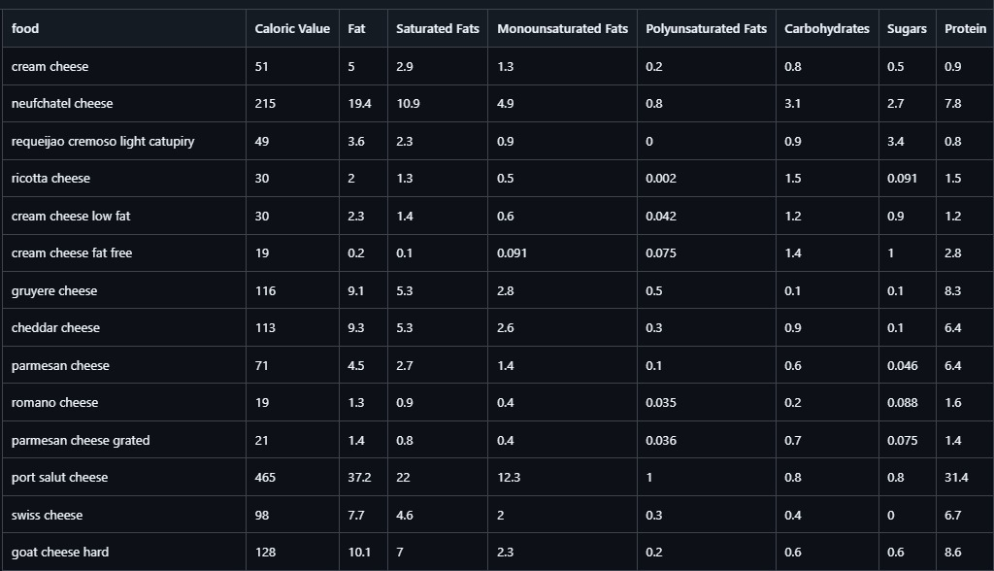
R1
Datasets
OBJECTIVE
This project focuses on creating a caloric estimation tool for food items using image recognition and machine learning.
TABULAR :Tabular Dataset has 2394 instances and 34 attributes
IMAGE: Image Dataset has more than 12000 images.

Slide 4
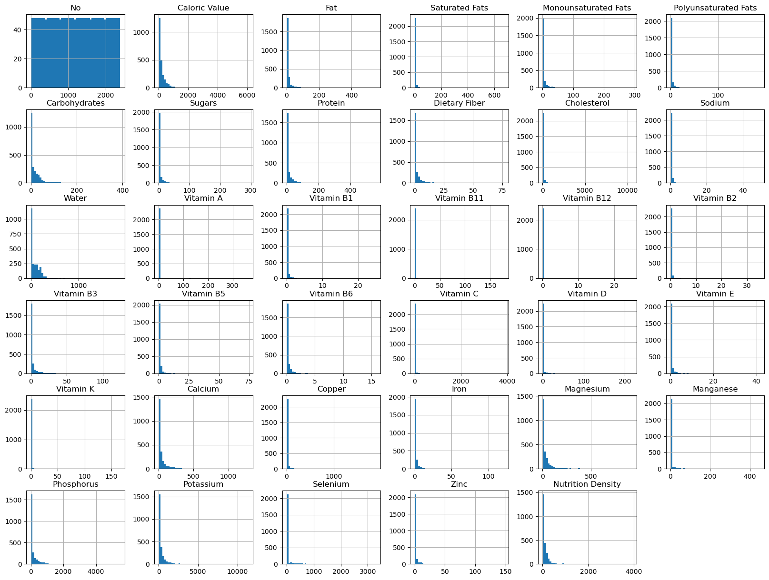
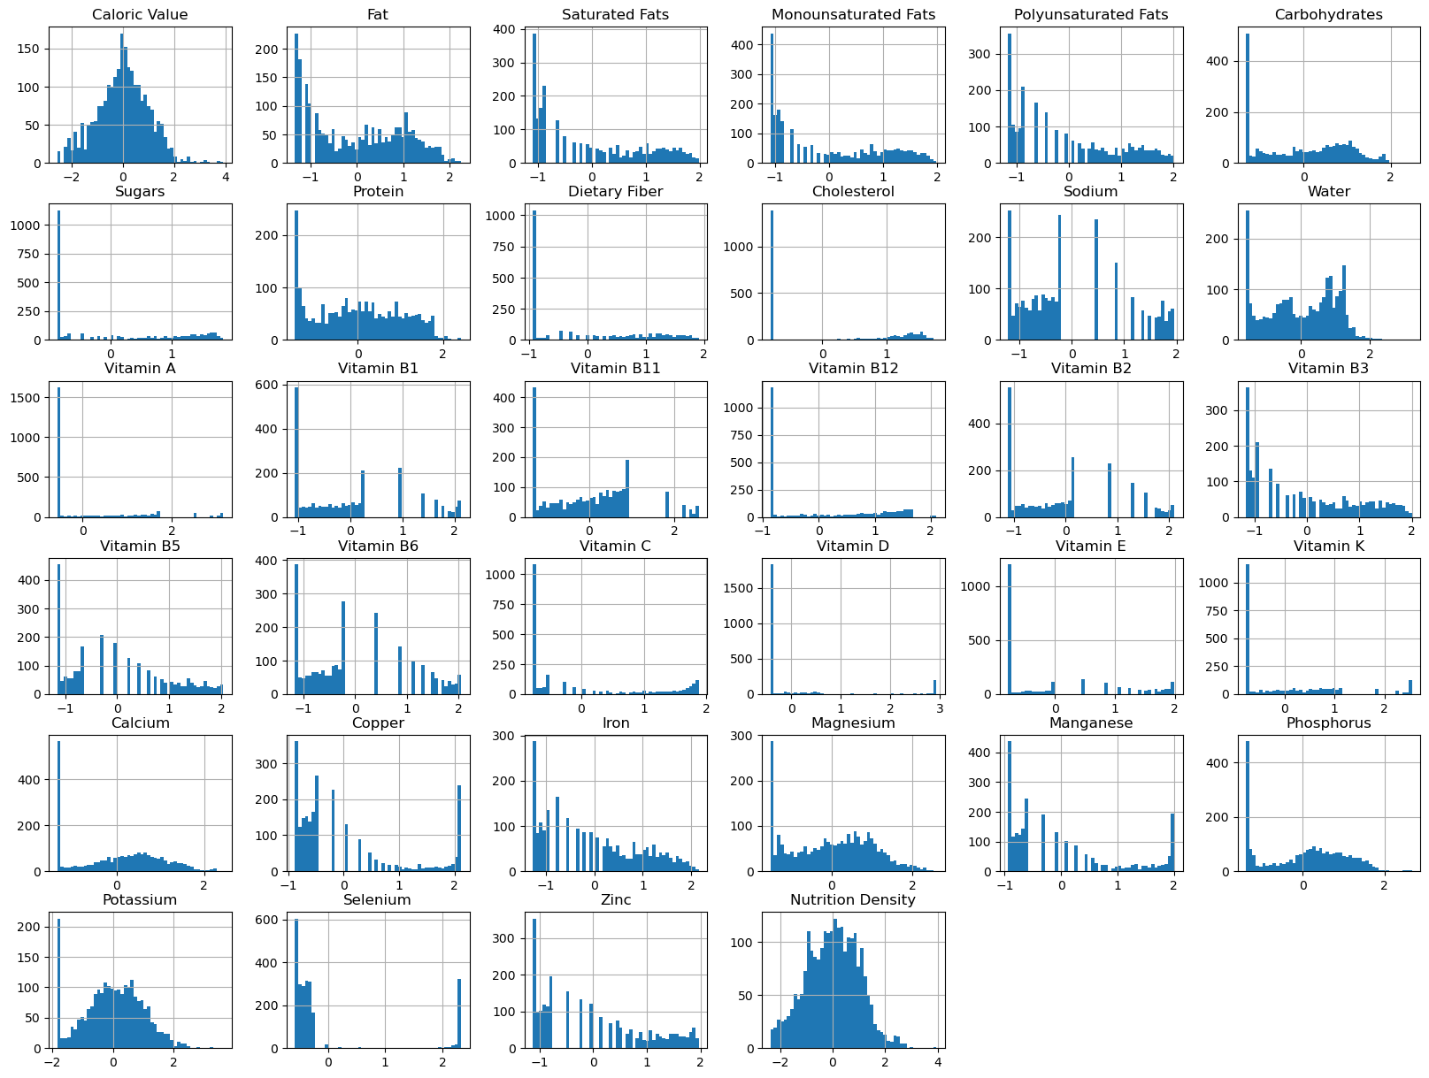
R2
DATA ANALYSIS AND EXPLORATION
Yeo-Johnson Transformation
From the first histograms, we observed that the data is skewed.
To achieve more normalization for the data, we used Yeo-Johnson Transformation which is used to stabilize variance
and make data more normally distributed

Slide 5
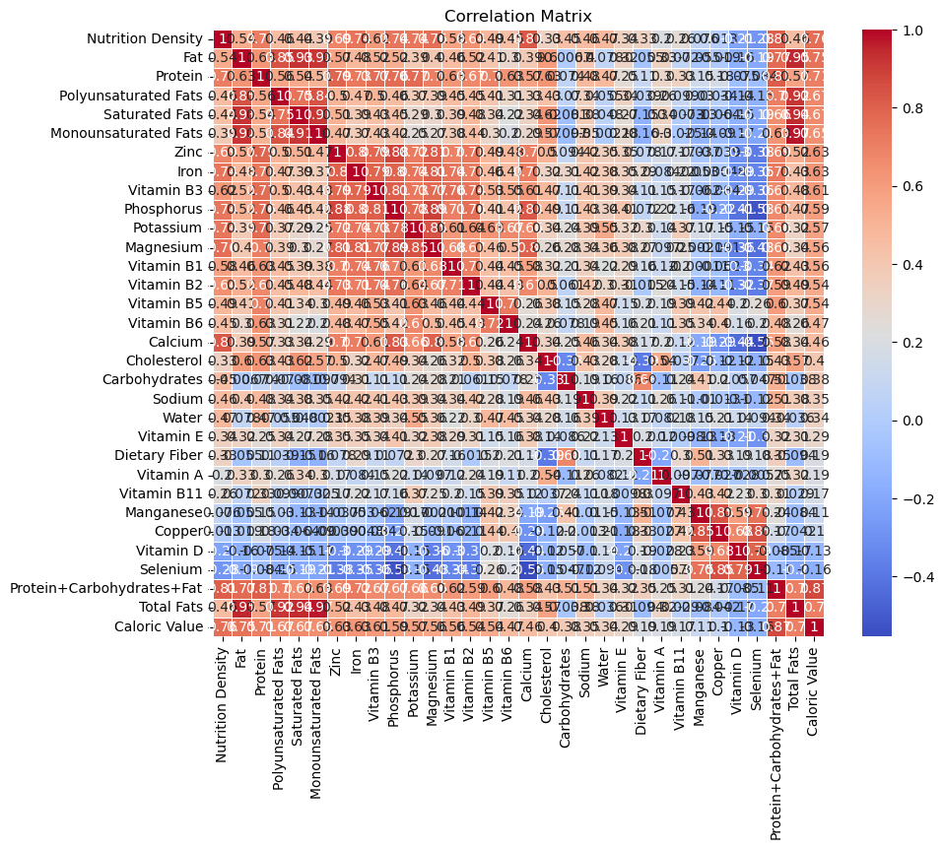
FEATURE SELECTION
Outlier Detection
z-score was used to determine outliers.
A value below-3 and above +3 is considered an outlier.
Pearson’s correlation coefficient
Used to measure the linear correlation between two variables.
We removed the found outliers.
Ranges from -1 to +1.
Feature Extraction
The correlation matrix reveals multicollinearity among certain features.
By removing these correlated features, we reduced redundancy in the dataset.
We used features with absolute correlation coefficient greater than 0.1 for further analysis.

Slide 6
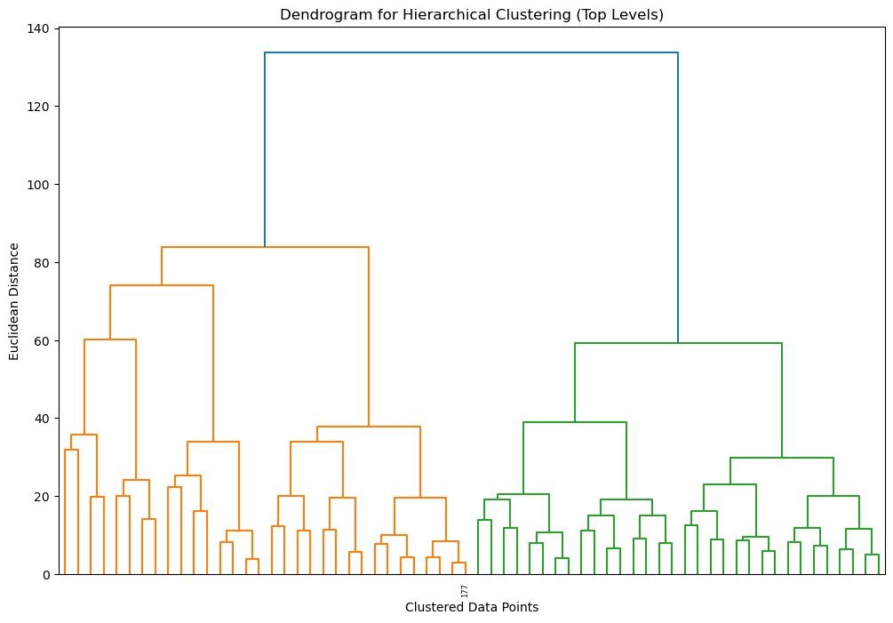
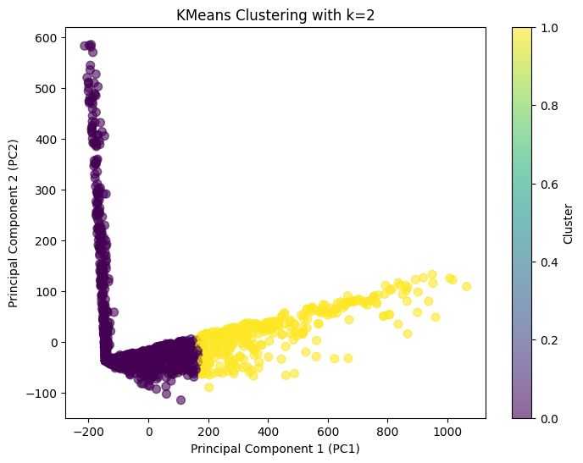
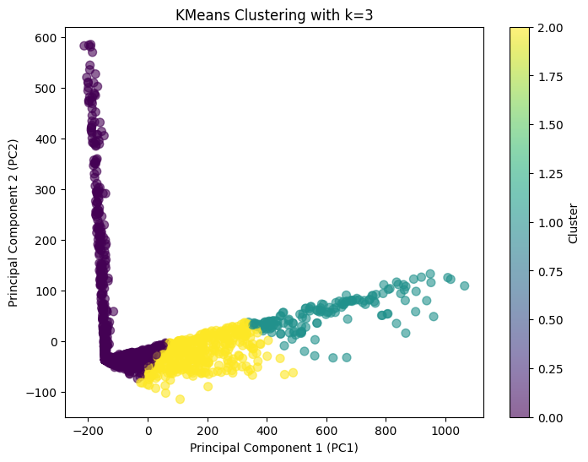
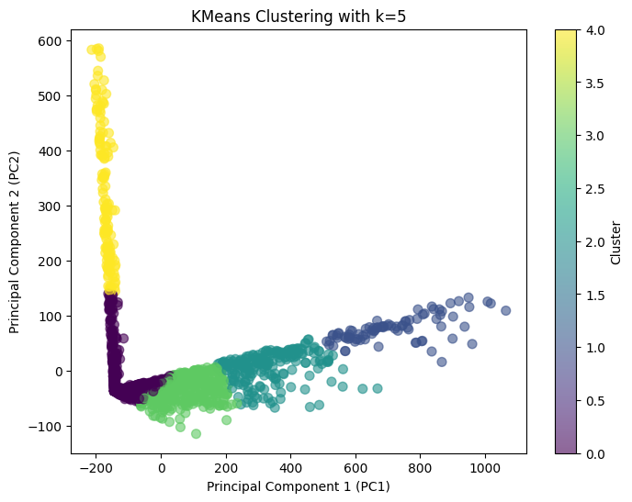
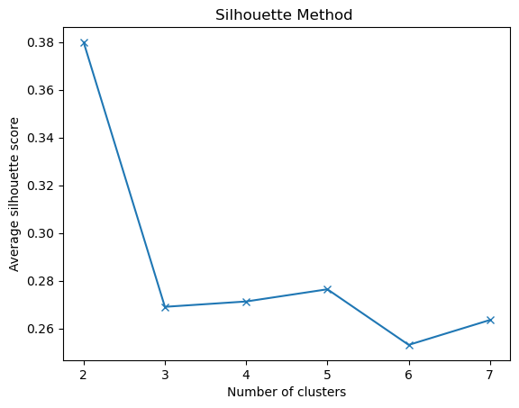
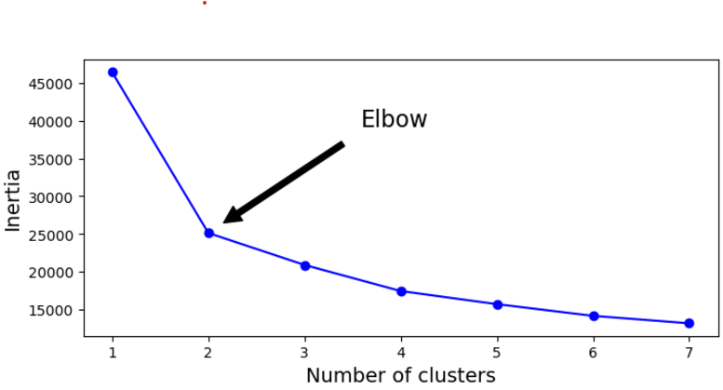
R3
CLUSTERING
Hierarchical Clustering
K-means clustering is a method to group data into *K* clusters by assigning points to the nearest cluster center and updating the centers until the groups stabilize.
To determine the optimal number of clusters (k) in k-means clustering, two commonly used methods are elbow method and silhouette method.
Hierarchical clustering is a general family of clustering algorithms that build nested clusters by merging or splitting them successively.
The largest distance at which clusters are merged (about 130 on the vertical axis).
the entire dataset into two main clusters represented by orange and green colour.
Elbow Method

Slide 7
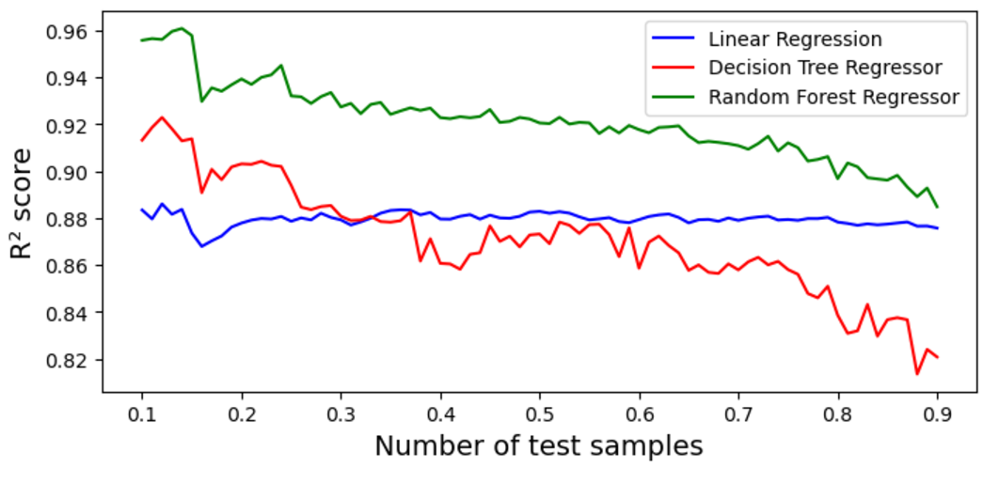
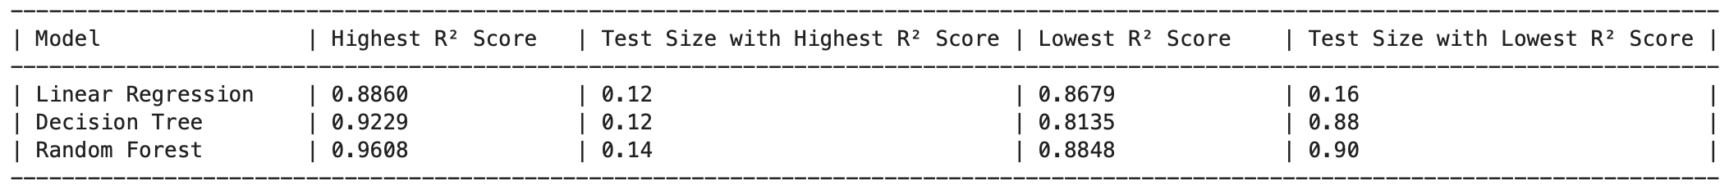
R4
BASELINE TRAINING AND EVALUATION EXPERIMENTS
MACHINE LEARNING ALGORITHMS USED
LINEAR REGRESSION
RANDOM FOREST REGRESSOR
DECISION TREE REGRESSOR
R² score against test size
Table with highest and lowest R² score for the models

Slide 8
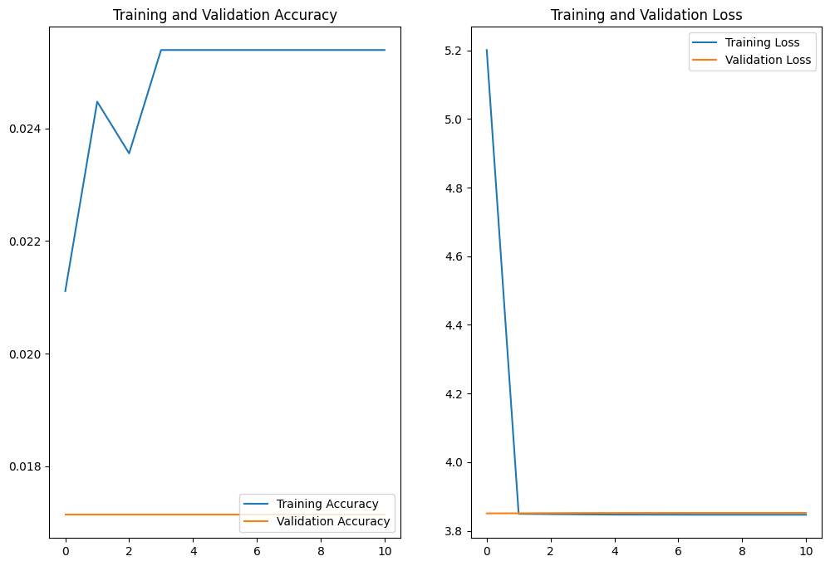
R5
NEURAL NETWORKS
Neural Networks are computational models that mimic the complex functions of the human brain.
The neural networks consist of interconnected nodes or neurons that process and learn from data.
MULTI LAYER PERCEPTRON
A Multi-Layer Perceptron consists of fully connected dense layers that transform input data from one dimension to another.
It is called “multi-layer” because it contains an input layer, one or more hidden layers, and an output layer.
MLPs aren't ideal for image data due to their inability to capture spatial relationships in images.
Validation Accuracy:0.0171358622

Slide 9
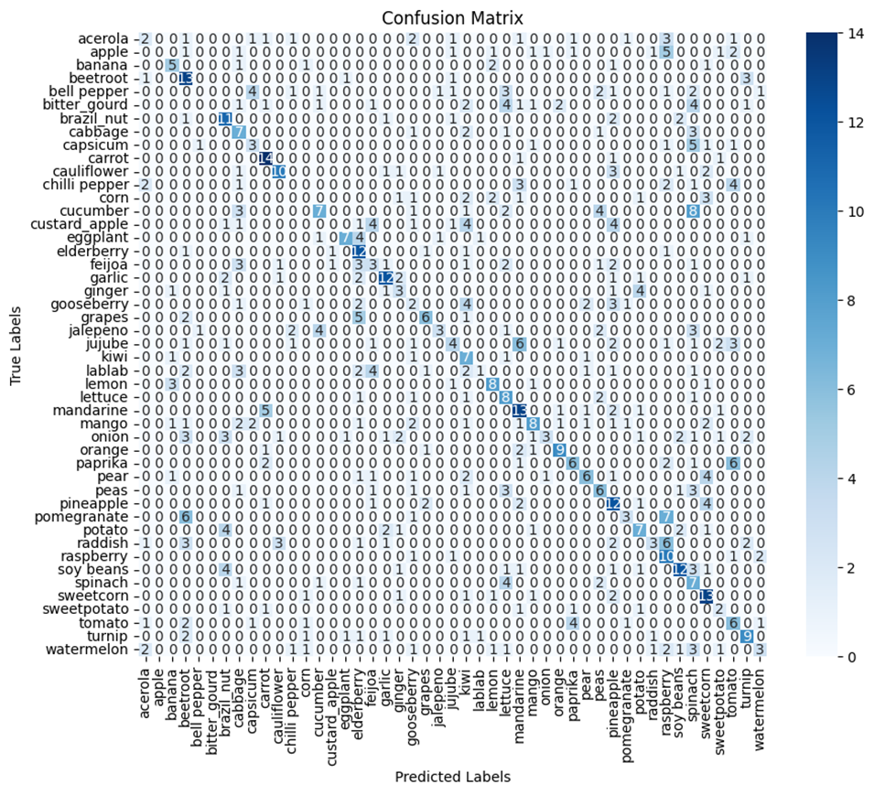
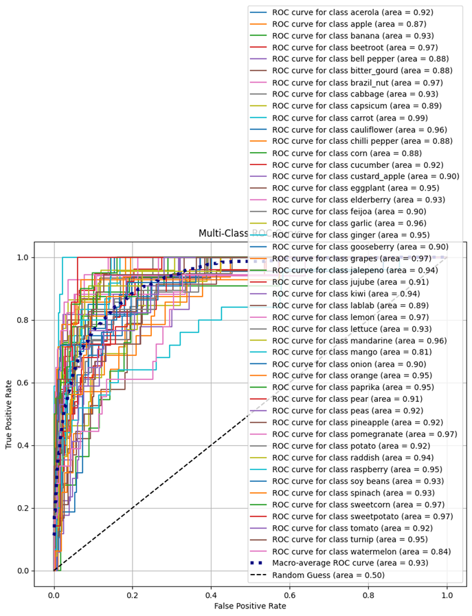
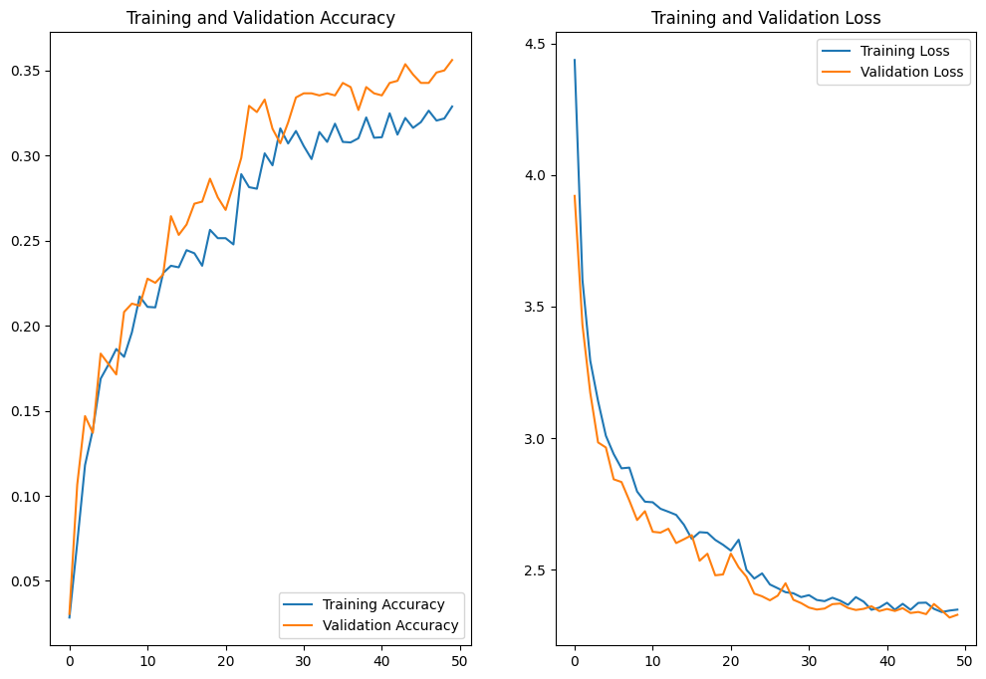
CONVOLUTIONAL NEURAL NETWORK
Convolutional Neural Network (CNN) is the extended version of artificial neural networks (ANN) which is predominantly used to extract the feature from the grid-like matrix dataset.
Widely used for image processing.
A CNN with 3 convolutional layers (128, 64, 32 filters), max-pooling, dropout for regularization, and a fully connected layer for classification.
The final softmax layer outputs probabilities for the len(class_names) classes.

Slide 10
CONCLUSION
Clustering
Regression
Classification
CNNs outperformed MLPs in image classification, achieving higher accuracy and better generalization by capturing spatial features. MLPs struggled with spatial data and showed overfitting. CNNs are the optimal choice for image classification tasks.
Both the Elbow and Silhouette methods suggest the optimal number of clusters is 2, which is also confirmed by K-Means clustering and the PCA visualization.
The Yeo-Johnson transformation and outlier removal enhanced model performance. Among the models, Random Forest was the best, offering the highest accuracy and stability, particularly with test sizes between 0.10 and 0.20.

